Slide 1




Survivor –Stickleback Fish Day 2
z

Slide 2
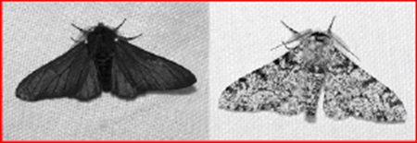
DQ
The habitat of a moth species included trees with both light and dark colored bark.
Therefore the moth species included both light and dark colored variants.
Then the light-colored trees were wiped out by a disease, and within a few years nearly all the moths in this forest were dark colored
Which of the following choices BEST explains what happened?
a. | The light moths changed their wing pigments to darker colors to avoid being eaten.
b. | The few light moths that survived did not mate, and therefore they had no offspring.
c. | The dark moths were less visible to predators, so mostly light moths were eaten.

Slide 3
Survivor –Stickleback Fish Day 2
STANDARDS
8.LS4.3 Analyze evidence from geology, paleontology, and comparative anatomy to support that specific phenotypes within a population can increase the probability of survival of that species and lead to adaptation.
8.LS4.4 Develop a scientific explanation of how natural selection plays a role in determining the survival of a species in a changing environment.
SEP: Engaging in argument from Evidence
CCC: Cause and effect
I Can:
Analyze evidence from geology, paleontology, and comparative anatomy to support that specific phenotypes within a population can increase the probability of survival of that species and lead to adaptation.
Develop a scientific explanation of how natural selection plays a role in determining the survival of a species in a changing environment.

Slide 4
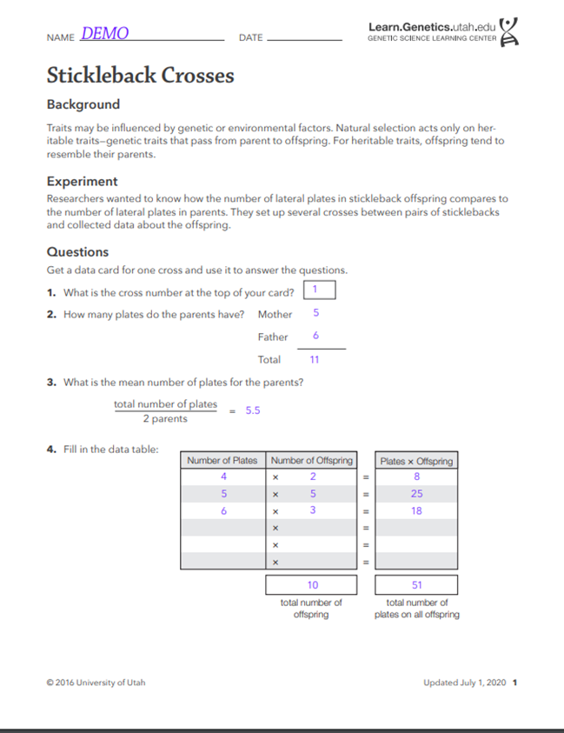
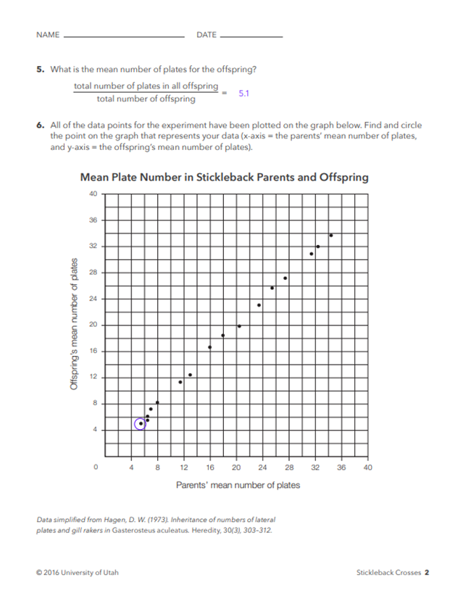
Heritability
Analyzing Data: Stickleback Crosses
• Is the lateral plate trait heritable?
8.LS4.3
8.LS4.4

Slide 5
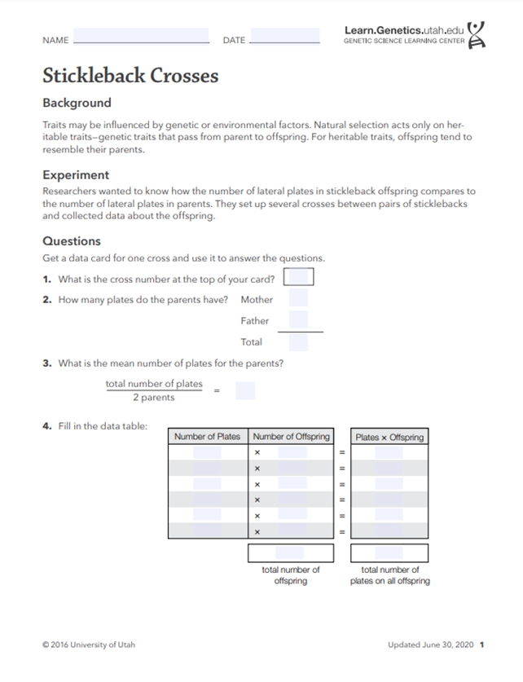
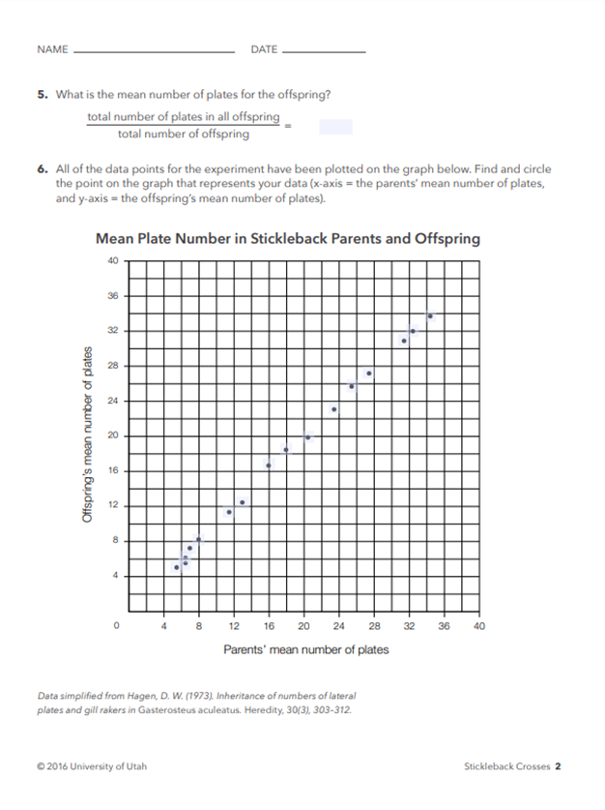
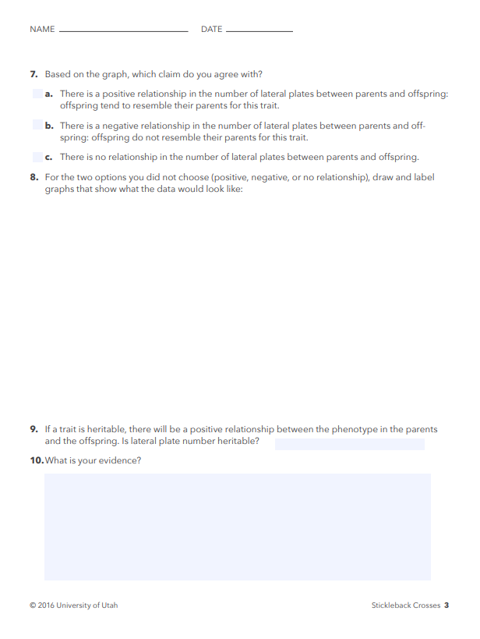
Fill in your paper for Heritability
8.LS4.3
8.LS4.4

Slide 6
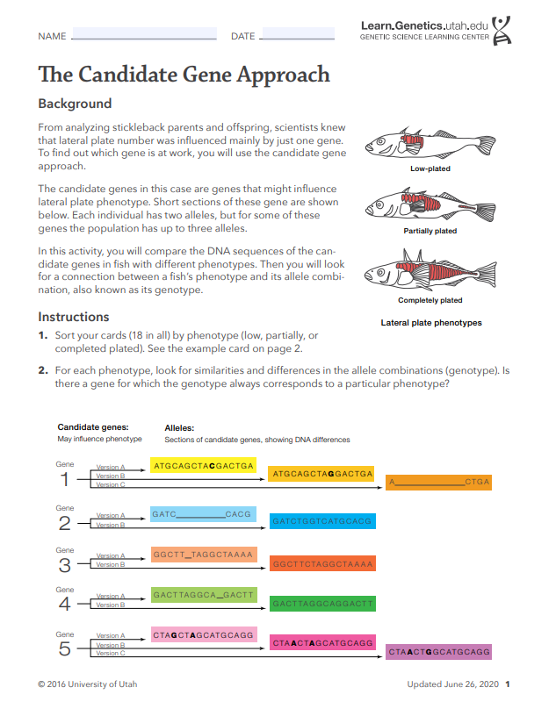
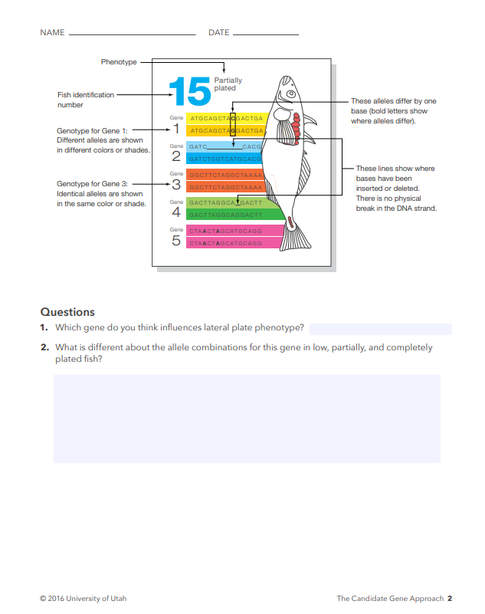
Sort your cards (18 in all) by phenotype (low, partially, or completed plated)
For each phenotype, look for similarities and differences in the allele combinations (genotype). Is there a gene for which the genotype always corresponds to a particular phenotype?
Which gene do you think influences lateral plate phenotype?
What is different about the allele combinations for this gene in low, partially, and completely plated fish?
8.LS4.3
8.LS4.4

Slide 7
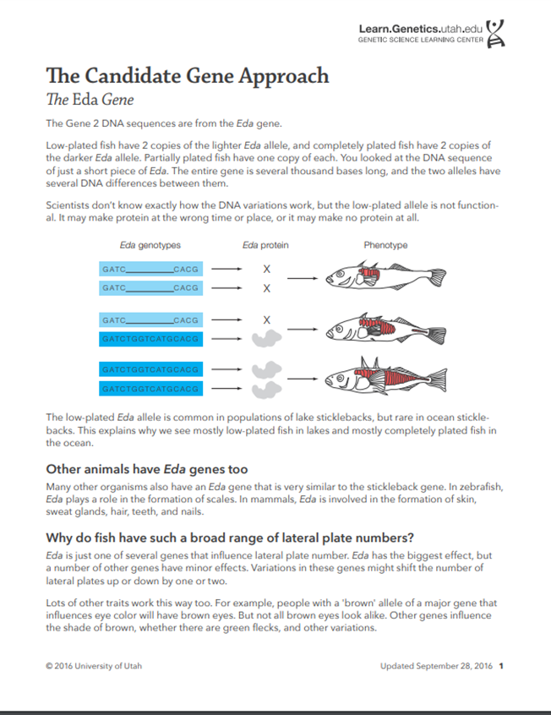
8.LS4.3
8.LS4.4

Slide 8
Phenomenon Model Revision: Go back to your initial model and use newly learned information to revise your model and explanation of the anchoring phenomenon.
8.LS4.3
8.LS4.4

